Slide 1
Martha Graham
Alyssa Faustin

Slide 2
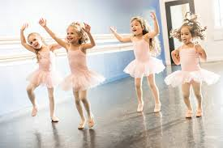
My research
I argue that kids should be able to learn modern dance at a young age. They should start with Graham technique created by modern dance virtuoso Martha Graham. Graham movement introduces difference in movement aesthetics of technique. It provides a look that is completely different from Ballet.
I ask: Why keep kids away from other ways of dancing?
Teaching one style will make them lack versatile ways of moving. Learning technique is harder as one grows older. Introducing multiple ways of moving will improve dancers’ chances of being versatile artists.

Slide 3
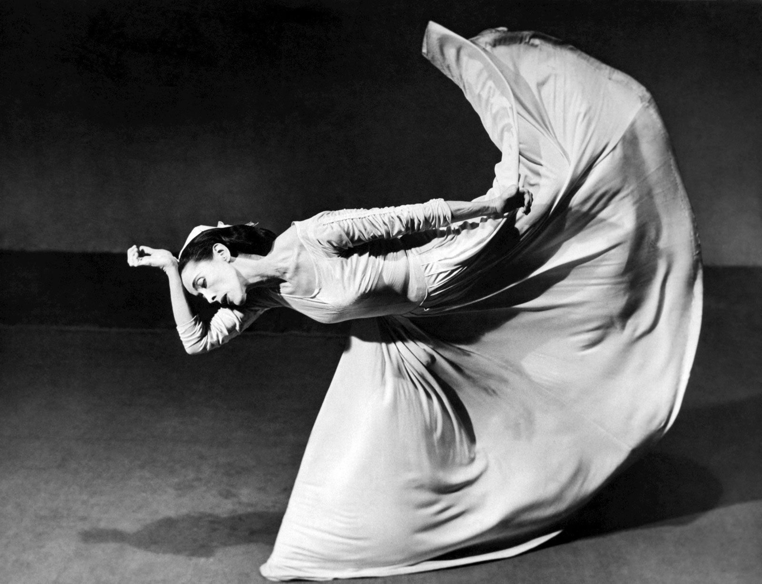
Martha Graham
Martha Graham was not afraid to be different. She took risks and was comfortable in her skin. Martha Graham stood out by being different and doing what she felt.
In developing her technique, Martha Graham experimented endlessly with basic human movement, beginning with the most elemental movements of contraction and release. Using these principles as the foundation for her technique, she built a vocabulary of movement that would “increase the emotional activity of the dancer’s body.”

Slide 4
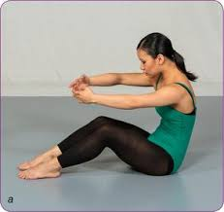
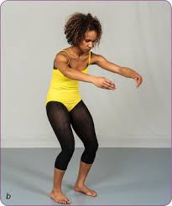
Why Martha Graham technique should be used?
The purpose of Martha Graham technique is to learn moves on the floor then work yourself up.
Martha Graham focuses on back strength with the use of a contraction.

Slide 5
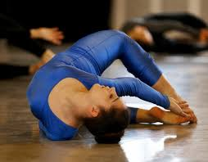
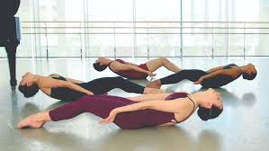
Graham Technique
Graham focuses on breathing that deepens the stretch as well as helps with the flow of movement. As dancers, we tend to hold our breaths, which makes it harder for us to express fully within the phrase.
This breathing technique is used with contractions and releases.
The floor work helps you initiate movement on the floor before one does it off the floor. It strengthens your back, which is an extremely useful technique. Also she uses a lot of torso stretches, such as pleading, which works on the strength of the abdominal muscles improving the dancer’s balance.
Learning these techniques at a young age will give strength to the dancer. Graham should supplement ballet that will result in improvement of balance in releve.

Slide 6
Continue Graham Technique
“It would be laboratory for analyzing weight and gravity, issues central to the definition of the new genre of modern dance (in defiance of the soaring upward thrust of ballet)”.
“In graham technique and theatre the act of falling embodies the process by which the dancer continually renews herself and it is a metaphor or the constant regeneration of life's energies on the face of certain mortality.”
“Preparation for fall cycle includes strengthening the thighs so that the dancer can negotiate the descent to the ground and avoid damaging the knees, discovering the power of the contraction and the release to instantly mobilize the body, and identifying the body's center of weight so that the action of falling can be controlled.”

Slide 7
Graham’s work focused on the human condition, including the inhumane behavior of ugliness, greed, and cruelty of arrogance.
For example, Graham herself said, “Chronicle does not attempt to
show the actualities of war; rather, by evoking war’s images, it sets forth the fateful prelude to war, portrays the devastation of spirit which it leaves in its wake, and suggests an answer” (Graham,quoted in program for BAM performance, 1994).
She hoped to inspire change in the world, to make us reflect, think, and transform as she did in her choreography. She wanted us to breathe and turn inward so as to reflect on what it means to be fully human.

Slide 8
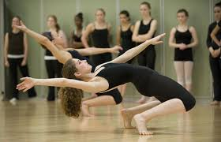
Graham created movement that was the antithesis of the ballet aesthetic in the 1920s; it was weighted, percussive, muscular, forceful, bold, angular, stark, and did not mask labor and grit.
“I learned how to see my body as strong, competent, and able to take risks, to push myself beyond what I thought was possible, which fed into my sense of self confidence and competence”.
“The dance studio can be a place to explore new ways of moving, and thus open doors to new ways of feeling. I see the strength of embodying the Graham Technique, a form that was rooted
in a woman’s perspective and approach to expression, to challenge socialized gender roles. In the technique, a wide range of expressions are explored. The body is strengthened and dancers are encouraged to reach their full body potential”.

Slide 9
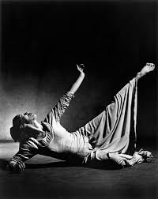
Martha Graham Floorwork
Professor Kim Jones stated like a baby crawls before walking, Martha Graham works with movement on the floor before trying to do it while standing. This further strengthens the dancers.
In the article “When Your Heart Falls The Drama Of Descent In Martha Graham’s Technique and Theater”, the article talks about the physical act of falling. Martha Graham was a technique of falling to the ground but not collapsing but she created possibilities for exploring an entirely new plane of dramatic space such as the floor.

Slide 10
Videos
Spilt falls
Floorwork video

Slide 11
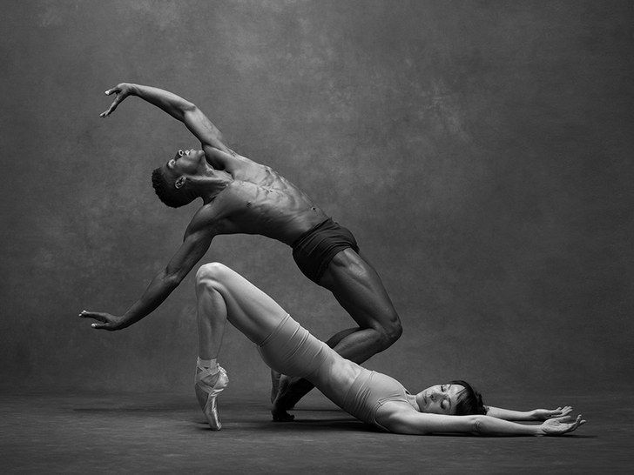
With the floor work there’s an exercise for every movement that will be progressed further in a standing position.
The contraction starts on the floor; when the women does the spilt fall she contracts first and lowers herself down.
Starting on the floor is helpful for understanding the movement and have the support of the ground that is always holding you up. Getting the appropriate strength will help with the movement when you're going to try them on your feet.

Slide 12
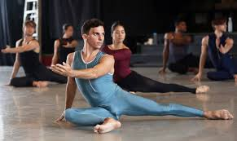
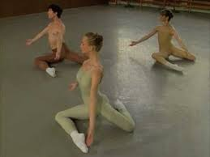
Graham technique that helps with Ballet

Slide 13
Conclusion
Children should be introduced to styles of dance other than just ballet to prepare for western concert performance. Children shouldn't be introduced to other styles of dance in college because they lose so many years of learning other cultural expressions and other technical concepts. Learning about Martha Graham’s impact should help students to discover their own passions. Students should be educated in multiples forms and histories of dances so they can understand the variety embedded within this discipline.
Starting young gives you more time to be aware of what you need to work on! Starting on the floor makes you more comfortable, such that when you try it standing up, you have a better understanding of why it felt a certain way on the floor.

Slide 14
Work Cited
“Martha Graham – The Graham Technique.” Human Kinetics, us.humankinetics.com/blogs/excerpt/martha-graham-ndash-the-graham-technique.
Graff, Ellen “When Your Heart Falls: The Drama of Descent In Martha Graham’s Technique and Theater”, Women & Performance: a journal of feminist theory, 14:1, 107-115.
Heather Harrington (2020) Female Self-Empowerment through Dance, Journal of Dance Education, 20:1, 35-43.
Jones, Kim. American Modernism: Reimagining Martha Graham’s Lost Imperial Gesture (1935) 2015.

