Slide 1
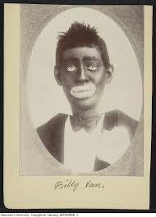
THE EFFECTS OF MINSTRELSY IN RACE THEORY
Rachel Bierly

Slide 2
Introduction
What is critical race theory
History of Minstrelsy
What is blackface
How race theory and minstrelsy tie together
”Body Impossible” choreographic analysis of Othello

Slide 3
Critical Race Theory: Origins, Importance, and application
Definition: the view that race is socially constructed and functions to maintain the interests of the white population that constructed it.
CRT goes back much further, however the movement officially organized itself in July 1989
A valuable perspective on race and racism in America.
Inspired by the American civil rights tradition through figures such as M.L.K, Jr. and W.E.B. Du Bois.
Advanced theoretical understandings
Notes:
4th bullet: Du Bois: American sociologist and social reformer
5th bullet: of the law, politics, and American sociology that focused on efforts of white people to maintain their historical advantages over people of color.

Slide 4
History of Minstrelsy
Concept of Minstrelsy started in the mid 20th century
Early minstrelsy shared three primary characteristics: “invocation of the ethnically and racially exotic/primitive”; absurdity, irreverence, and recklessness, and longing for an ideal rural paradise.
1843 – Blackface performers came together in a single troupe and called themselves, Minstrels.
Officially started in the abolitionist movement which turned the attention to free blacks
Most Minstrels were Irishman performing black characters
Notes:
1st bullet: which was based on popular depictions of Black Americans
2nd bullet: According to music scholar Jon W. Finson
3rd: First form of national popular entertainment
Minstrel: a member of a band of entertainers with blackened faces who performed songs and music ostensibly of black American origin.
4th: Slavery was abolished in 1865
5th: to distance themselves from their own lower social, political and economic status in the US.

Slide 5
Blackface
Primary function was to act as a mask and invoke the other.
Allowed actors and artists to hide behind a caricature while protesting and mocking the powerful without fear of retaliation.
Performers could safely question authority while claiming to be acting out authentic African American expressions.
Some white performers augmented their noses and other features when performing to look more stereotypically “black.”
Would always be Janus-faced, allowing performers to speak freely against the interests of the powerful.
Dangerously dehumanized blacks by introducing and reinforcing racial stereotypes.
Prevented blacks from representing themselves.
Notes:
Invoke: African American vernacular
Janus-faced: insincere or deceitful – having two sharply contrasting aspects of characteristics
Would darken their face with shoe polish, greasepaint, or burnt cork

Slide 6
Race theory and Minstrelsy
Slavery was commodification of black labor; minstrelsy was the commodification of black culture.
Depictions of blacks in minstrel performances were exaggerated, dehumanizing, and inaccurate.
Blackface minstrel performers reflected and reinforced white supremacy.
”It’s an assertion of power and control and allows a society to routinely and historically imagine African Americans as not fully human. It serves to rationalize violence and Jim Crow segregation.” – David Leonard
Portrayed negative stereotypes about African Americans
Blackface was in theaters and film industry.
The Birth of a Nation, characters were unscrupulous and rapists
Stereotypes became so powerful they became a recruiting tool for the Ku Klux Klan
Notes:
David Leonard – Professor of comparative Ethnic Studies and American Studies and Culture
Jim Crow – collection of state and local statutes that legalized racial segregation. Named after the black minstrel show character.
5th: including being lazy, ignorant, superstitious, hypersexual, criminal, or cowardly

Slide 7
Documentary video:
Historical Reflections of Bias
Ethnic Notions Documentary
44:25 – 45:25

Slide 8
“Body Impossible”: Chapter three
American Ballet Theatre and San Francisco Ballet’s Othello:
Lar Lubovitch choreographed ABT and SFB’s co-production of Othello in 1997, where there was an absence of black male dancers in ABT.
Desmond Richardson would perform the part of Othello and when he wasn’t, alternate casts were painted in bronze face and body makeup.
Othello compels a consideration of the haunted and unexamined relationship between blackface, virtuosity, and racial melodrama in ballet.
In Richardson’s absence, the casts are painted in blackface to supplement an attempt to affectively recover his virtuosity.
Blackface functions as one of several intertwined elements in the attempt to embody the Other.
Richardson’s performance of Othello is an instantiation of “black-on-black minstrelsy.”
Notes:
2nd: Desmond Richardson: concert dance career started at Alvin Ailey. African American dancer who has mastered hip-hop, classical, modern, and contemporary ballet. First African American principal dancer since the inception of ABT.

Slide 9
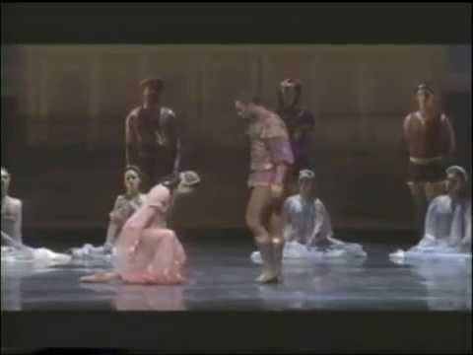
Choreographic Analysis of Othello
Background about the piece
Abrupt
Percussive
Strong
Quick
Silly / Showing off
Sustained
Tapestries
Anger
Bound
Controlled
Sadness
Notes:
Background: Moorish general, Othello, is led through lies and deceit of closest friend, Lago. He’s led to believe his wife, Desdemona, is unfaithful. In his heartbreak and anger, he kills her and afterwards, himself.

Slide 10
Conclusion – Why it is important
Blackface is still being portrayed today
The appeal of blackface was declined after the 1930s and continued into the Civil Rights Movement.
Example of blackface today: in 2012 at the Oscars ceremony, blackface appeared on television skits, and wearing blackface to dress up as famous African Americans during Halloween.
David Leonard says, “Blackface is part of the toxic culture of racism.”
Stereotyping is representational violence

Slide 11
Citations
Clark, Alexis. “How the History of Blackface Is Rooted in Racism.” History.com, A&E Television Networks, 13 Feb. 2019, www.history.com/news/blackface-history-racism-origins.
Ethnic Notions, California Newsreel, 20 Nov. 2014, fod-infobase-com.librarylink.uncc.edu/p_ViewVideo.aspx?xtid=49775.
Graves, Nadine George-. “3.” In Ballroom, Boogie, Shimmy Sham, Shake: A Social and Popular Dance Reader, University of Illinois Press, 2009, pp. 55–71.
Purdue Writing Lab. “Critical Race Theory // Purdue Writing Lab.” Purdue Writing Lab, owl.purdue.edu/owl/subject_specific_writing/writing_in_literature/literary_theory_and_schools_of_criticism/critical_race_theory.html.
Scott, Ariel Osterweis. “Body Impossible: Dynamics of Race, Sexuality, and Virtuosity in the Dance of Desmond Richardson.” University of California, Berkeley, 2011.
“Summary of The History of Minstrelsy · USF Library Special & Digital Collections Exhibits.” Omeka RSS, exhibits.lib.usf.edu/exhibits/show/minstrelsy.

